Slide 1
GIT
By Lihalakha Cetric

Slide 2
Git
Git → a distributed version-control system for tracking changes in source code during software development.
It is designed for coordinating work among programmers, but it can be used to track changes in any set of files.
Its goals include speed, data integrity, and support for distributed, non-linear workflows.

Slide 3
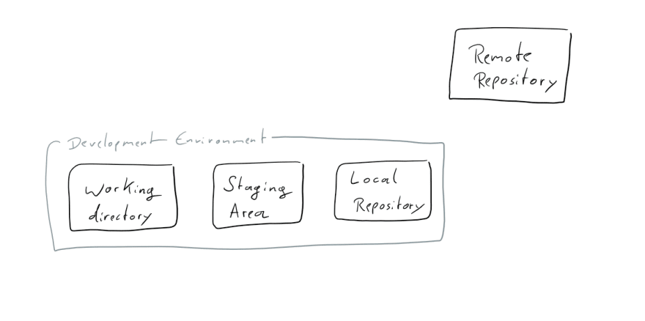
Overview
The 4 boxes

Slide 4
OVERVIEW
Remote Repository → where you send your changes when you want to share them with other people, and where you get their changes from.
Development Environment → what you have on your local machine.
Development Environment → comprises of Working Directory, the Staging Area and the Local Repository.

Slide 5
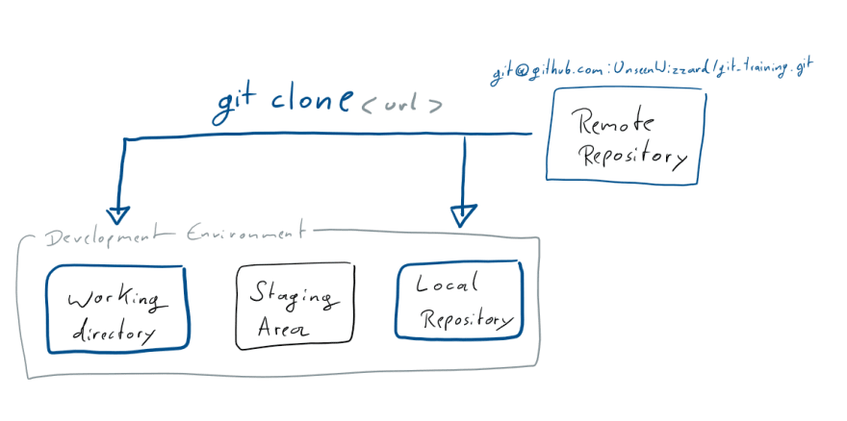
GETTING A REMOTE REPO
Github
cloning

Slide 6
GETTING A REMOTE REPO
Git clone → copies the Remote Repository into two places, your Working Directory and the Local Repository.
How git is distributed version control → The Local Repository is a copy of the Remote one, and acts just like it. The only difference is that you don't share it with anyone.
Git clone → create a new folder wherever you called it.

Slide 7
STARTING A GIT PROJECT
Choose a place in which you want to put your Development Environment.
go to your home folder, or where ever you like to put your projects.
Git init

Slide 8
ADDING NEW THINGS
Let's create a new file
What you've just done is add the file to your Working Directory.
There's two kinds of files in your Working Directory: tracked files that git knows about and untracked files that git doesn't know about (yet).
git status → see what's going on in your Working Directory

Slide 9
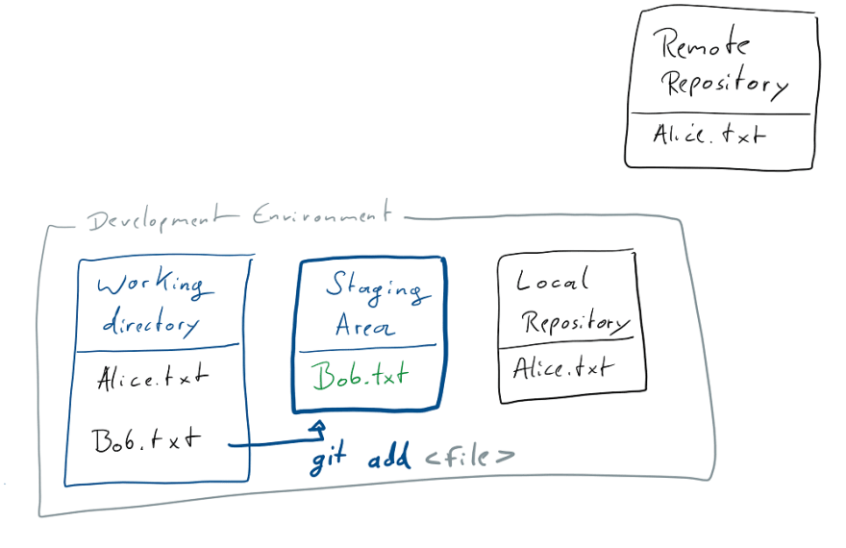
ADDING NEW THINGS

Slide 10
COMMIT
Added all your changes?
Commit what you just did to the Local Repository.
Git commit → a text editor will open and allow you to write a message telling everything what you just did. When you save and close the message file, your commit is added to the Local Repository.
git commit -m

Slide 11
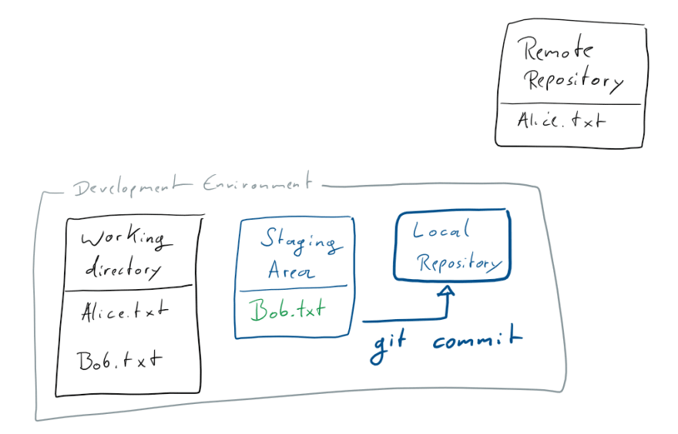
COMMIT

Slide 12
NEXT??
Now your changes are in your local repository, which is a good place for the to be as long as no one else needs them or you're not yet ready to share them.
In order to share your commits with the Remote Repository you need to push them.

Slide 13
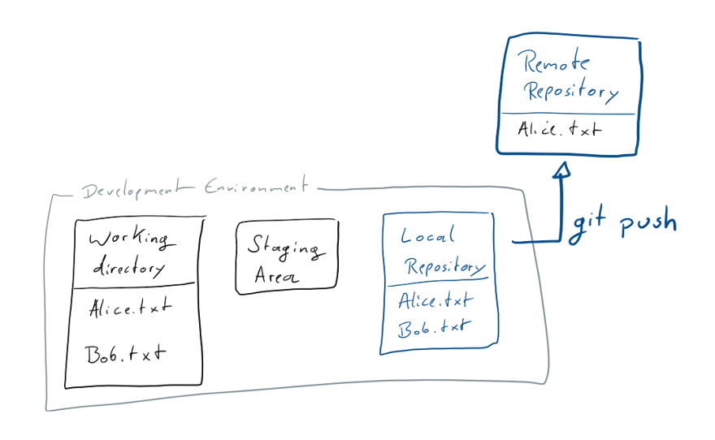
GIT PUSH

Slide 14
PUSH
Git push → changes will be sent to the Remote Repository.

Slide 15
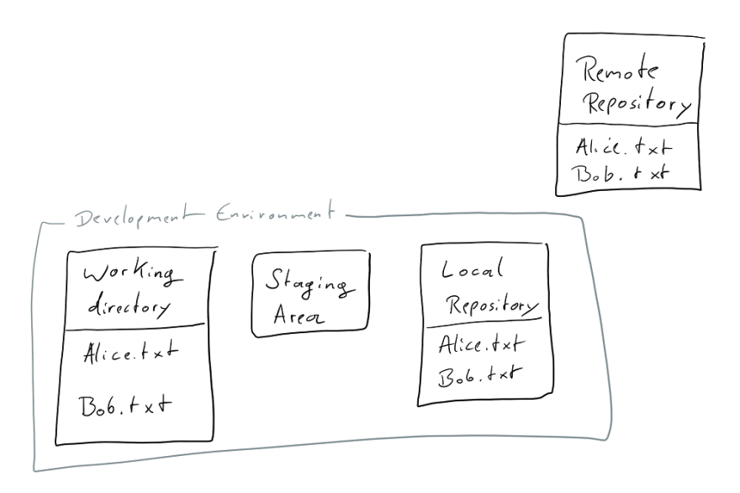
STATE AFTER PUSH
,

Slide 16
MAKING CHANGES
More interesting part of version control is changing files.
Let’s make some changes to Bob.txt!
run git status
What do you see??
you'll see that Bob.txt is modified
changes are only in your Working Directory.
git diff → see what has changed in your Working Directory

Slide 17
MAKING CHANGES
git add → this moves your changes to the Staging Area.
We dont like the changes we made, make new changes
run git status , what do you see?
two changes, one we already staged and one we just made, which is still only in the working directory.

Slide 18
MAKING CHANGES
ready to commit what we just did
the changes are now in the Local Repository.
git log → a list of all the commits with their hash as well as Author and Date, we also see the state of our Local Repository and the latest local information about remote branches.

Slide 19
BRANCHING
Most work-flows with git include making your changes on a branch, before you merge them back into master.
Right now we want to create a branch to make some changes there.
Branches live in the Local and Remote Repository.
When you create a new branch, the branches contents will be a copy of the currently committed state of whatever branch you are currently working on.

Slide 20
BRANCHING
Git branch → adds the new branch to the Local Repository.
Git checkout → switch to another branch
Let's make some change to Alice.txt
While your Working Directory and Staging Area don't really care about branches, you always commit to the branch you are currently on.

Slide 21
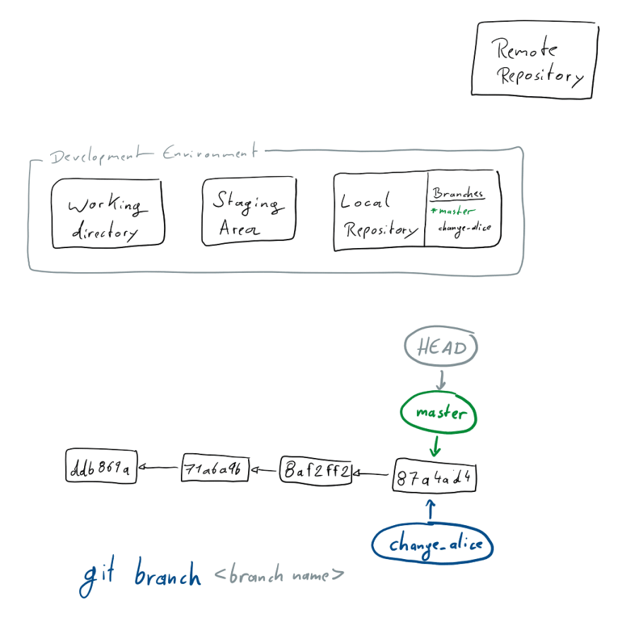
BRANCHING

Slide 22
MERGING
how to get changes from one branch into the other by merging them.
We've just changed Alice.txt on the change_alice branch
we're happy with the changes we made.
git checkout master→ commit we made on the other branch will not be there
merge the change_alice branch into master.
you always merge some branch into the one you're currently at.

Slide 23
MERGING
Fast-Forward merging → no other conflicting changes
Merging divergent branches ->

Slide 24
REBASING
clean way to integrate changes between two branches
a branch is always based on another. When you create it, you branch away from somewhere.
When a branch is diverging from the one it's based on and you want to integrate the latest changes back into your current branch, rebase offers a cleaner way of doing that than a merge would.

Slide 25
Updating WITH remote changes
we've only learned how to make and share changes
Changes in remote repo by other people!
get their changes from the Remote Repository into our Dev Environment

Slide 26
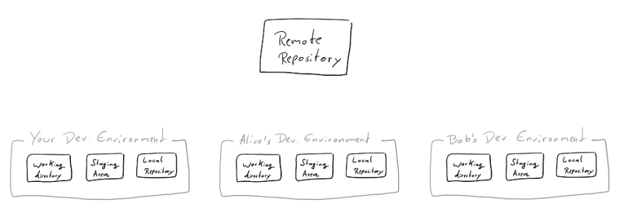
Updating WITH remote changes

Slide 27
Updating WITH remote changes
Go to github again
Edit Alice.txt file.
git push → you synchronize changes made to the Local Repository into the Remote Repository.
git fetch → get changes made to the Remote into your Local Repository
changes aren't integrated into the local branches and thus the Working Directory and Staging Area yet

Slide 28
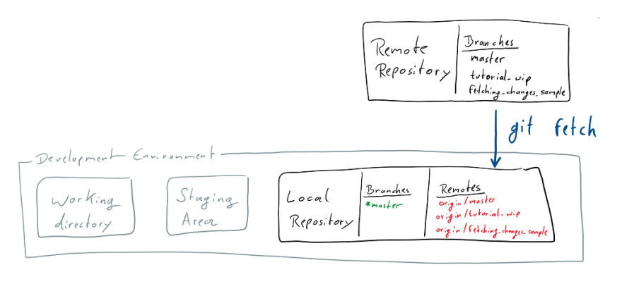
GIT FETCH

Slide 29
GIT FETCH
run git status

Slide 30
GIT PULL
git pull -> get the changes from the Repository all the way into our working area.
You can not pull in any changes, while there are modifications to files in the Working Directory that are also changed by the commits you're pulling in.
"pull" command thus performs two operations: it fetches changes from a remote branch, then merges them into the current branch.

Slide 31
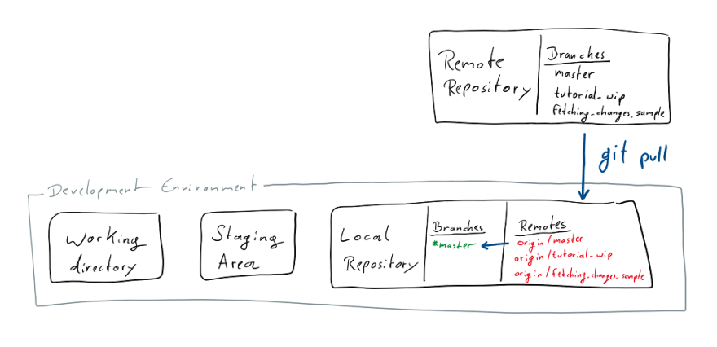
GIT PULL

Slide 32
THE END!

